Slide 1
Python
Flow control!
Woooo… fancy! :D

Slide 2
What is the Flow of the code?

Slide 3
What is the Flow of the code?
It’s the order in which our code gets executed!

Slide 4
What is the Flow of the code?
Think of a player going through a board in a board game…

Slide 5
What is the Flow of the code?
Think of a player going through a board in a board game…

Slide 6
What is the Flow of the code?
Think of a player going through a board in a board game…

Slide 7
What is the Flow of the code?
Think of a player going through a board in a board game…

Slide 8
What is the Flow of the code?
Think of a player going through a board in a board game…

Slide 9
What is the Flow of the code?
Think of a player going through a board in a board game…

Slide 10
What is the Flow of the code?
Think of a player going through a board in a board game…

Slide 11
What is the Flow of the code?
Think of a player going through a board in a board game…

Slide 12
What is the Flow of the code?
Think of a player going through a board in a board game…

Slide 13
What is the Flow of the code?
Think of a player going through a board in a board game…

Slide 14
What is the Flow of the code?
The player represents the computer

Slide 15
What is the Flow of the code?
The player represents the computer
Each hexagon tile represents an instruction (e.g a line of code)

Slide 16
What is the Flow of the code?
The player represents the computer
Each hexagon tile represents an instruction (e.g a line of code)
executing bits of code

Slide 17
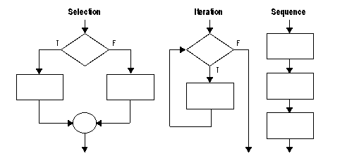
What is the Flow of the code?

Slide 18
What is the Flow of the code?
Flow structures
If / elif / else
While
For
Yes/no
question

Slide 19
What is the Flow of the code?
Flow structures
If / elif / else
While
For
Path A
Yes/no
question

Slide 20
What is the Flow of the code?
Flow structures
If / elif / else
While
For
Path A
Yes/no
question
Path B

Slide 21
What is the Flow of the code?
yes
Yes/no question
If
no

Slide 22
Why do we need to control the flow of the code?
It’s the order in which our code gets executed!

Slide 23
Different ways to control the Flow of our code…

Slide 24
Types of Control Flow: sequential

Slide 25
Types of Control Flow: sequential

Slide 26
Types of Control Flow: sequential
This is the one we have been using up until now.
The code is read from top to bottom - just like we humans read books, for example!

Slide 27
Types of Control Flow: sequential
Example:

